Slide 1
















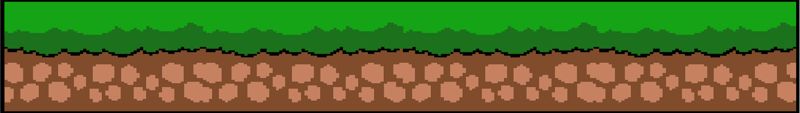
ArgueRPG:
The ai powered debate game
Notes:
Hello everyone, today i am going to be presenting my Project Proposal, "ArgueRPG".
So, what in the world is the problem?

Slide 2





What’s the problem?
5.8 - 6.0 million filipinos are illiterate
There is an existing portion of people with a limited vocabulary size
People are overly reliant on ai for essay and written assessments
studies have also shown that a large amount of both high school and university students suffer from public speaking anxiety (12.3 : 50-80 percent of high school students)
Notes:
The problem is, studies show that a significant amount of filipinos are illiterate or have a limited vocabulary size.
Not to mention the overreliance on AI for anything writing related.
Another fact is the ratio of 12.3% of college students as opposed to 50-80 percent of High school students having a fear of public speaking.

Slide 3




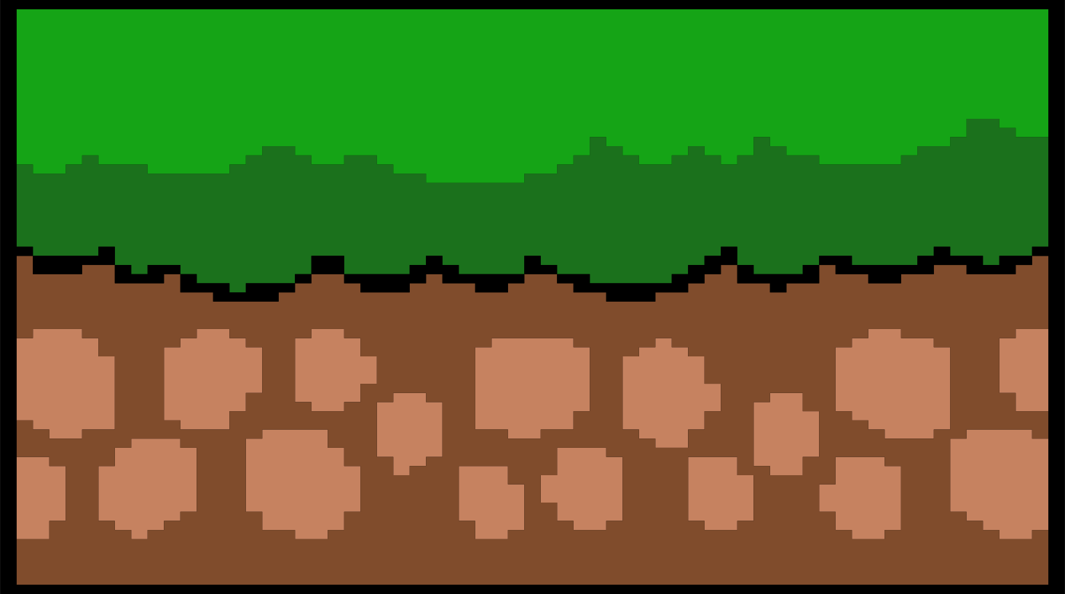

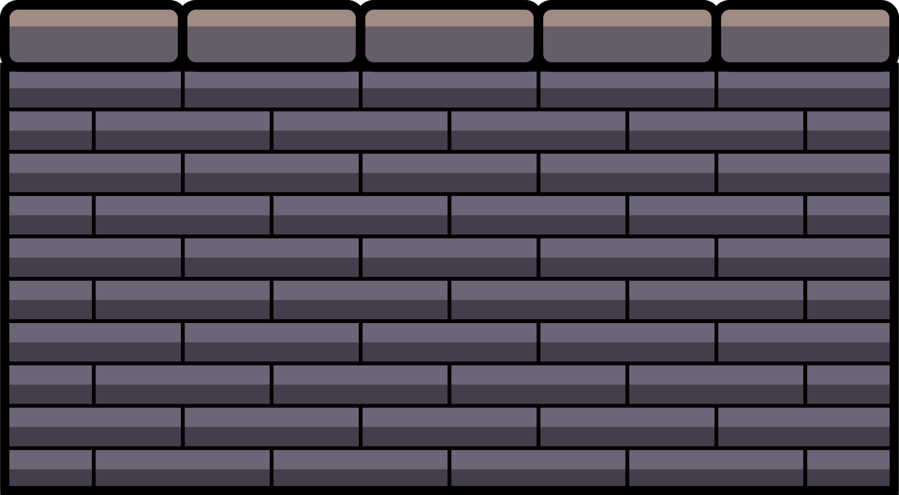
So,how do we fix this?
Notes:
now, whats our solution? Look no further

Slide 4


It’s simple,really.
ArgueRPG
ArgueRPG is an ai powered game about debating throughout multiple competitions, locations, levels, competitions, and events.
Its powered by the GPT-4o-mini model, the core of the game’s process. Its used to adjucate or review arguments for any improvements, and also encourage you to speak for what you defend.
This game is designed to help improve your literary skills, vocabulary, critical thinking, and your public speaking.
This game also aims to set an example of proper usage of AI, consdering the majority or students’s dependency on AI for their own essays and assesments.
Notes:
ArgueRPG is an AI powered game that literally just glazes debate. Its designed to fix the problem statements by using the way the human brain is wired to our advantage.

Slide 5
How does it work?
Notes:
"Kyro, how the hellion does this game work?"

Slide 6
It’s simple,really.
How I Did It
I used the power of Tkinter and Chatgpt API to pull together this game. The process for the actual rounds in the game are that the AI generates a random motion, the player gets their side, write their argument, submits it, then the AI puts together their own argument, (more yap in the paragraph below so js pay attention)
And once the two arguments have been submitted, the AI judges them both on built in criteria, with how convincing it is, how understandable it is, how much relevant evidence was used, format, and overall structure.
Notes:
I essentially just built a GUI with tkinter and built most of the backend process revolving the AI's function in the game.
Essentially just online debate, BUT adjucators and opponents are AI.

Slide 7

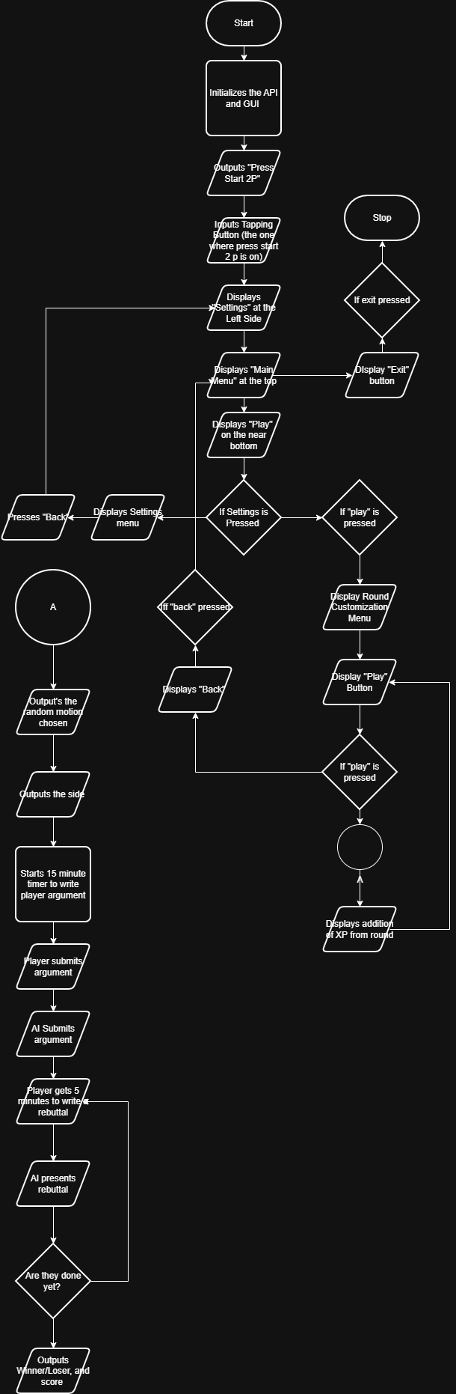
Process Flow Diagram
Notes:
Now, heres my boring looking Process Flow.

Slide 8
Process Flow Diagram

Slide 9

Questions and Concerns
Congrats on getting here! now you have to listen to me defend my project like its research defense. (get ready for yap)
Notes:
skip through the slides on ts

Slide 10
Questions and Concerns
“how are you so sure that this project can help people with the problems mentioned?”

Slide 11
Questions and Concerns
The human brain always chases dopamine, so by turning a boring solution into an energizing game, I believe that players may naturally want to continue playing and therefore fixing their problems.

Slide 12



Questions and Concerns
"How are you so sure that you can pull this project off?”

Slide 13


Questions and Concerns
Read this sentence carefully
It took me a solid 2 weeks of research, experiments, and sleepless nights to figure out how the whole thing would work

Slide 14
Questions and Concerns
ALso because the game has been in testing and debugging since last week.

Slide 15
Questions and Concerns
“Why tkinter and not another library for the gui?”

Slide 16
Questions and Concerns
Despite tkinter bottlenecking the performance, i think tkinter would be easiest for the situation of familiarity to fix. i wanted the game to be slightly self sustaining considering that.. (more yap in the next slide)

Slide 17
Questions and Concerns
Im a student, and rolling out updates every few months considering my tight schedule isnt necessarily something i can do easily. plus, the player base could learn tkinter themsevles and fix the gui if it broke (more yap in th enext slide)

Slide 18
Questions and Concerns
considering that python is a beginner language. i purposefully made the game easy to fix in the case of any bugs i dont catch. PLus, in the time i do update, it would also be easier for me.

Slide 19
Any more questions?
Congrats on getting here! now you have to listen to me defend my project like its research defense
Notes:
Now that we've went over the whole project, are there anymore questions and concerns?

Slide 20
References (my research </3)
Lungay, I. R. E. (2023). Public speaking anxiety in oral communication among Grade 11 students of PHINMA-COC. International Journal of Research and Innovation in Social Science, 7(5), 988–1025. https://econpapers.repec.org/article/bcpjournl/v_3a7_3ay_3a2023_3ai_3a5_3ap_3a988-1025.htm
Public speaking anxiety among senior high school students: A basis for enhancement program. (n.d.). International Journal of Research and Innovation in Social Science (IJRISS). (Study sample n = 274). https://rsisinternational.org/journals/ijriss/articles/public-speaking-anxiety-among-senior-high-school-students-a-basis-for-enhancement-program/
Bialen, V. B., Alabat, F. G., Gallogo, N. A., Escolta, M. S., Tulud, D. M., Magnaye, W. G., Salinas, M. V., Tikas, E., & Silva, R. L. (2025). Glossophobia and engagement in oral recitation among ESL learners. Journal of Basic Education Research, 6(2), 254–267. https://cahaya-ic.com/index.php/JBER/article/view/1790
Meneses, M. J. R., & Gonzaga, M. V. (2025). Public speaking anxiety of the senior high school students in Holy Cross College (Carigara, Leyte). FCIC Insights, 3(01), 1–23. https://insights.fcic.edu.ph/index.php/journal/article/view/23
Montero, A., Grefalde, B., Verano, C., & Abdurasul, D. (2024). Self-doubt and public speaking among senior high students: triggers and coping strategies [Qualitative study]. ESP Journal. https://esp.as-pub.com/index.php/esp/article/view/3840
Fagsao, J., & Mi-ing, J. G. (n.d.). Glossophobic experience amongst MPSPC pre-service teachers through oral speech presentations. Elsya: Journal of English Language Studies. https://journal.unilak.ac.id/index.php/elsya/article/view/5658
Chavez, J. V. (2023). Constant participation in public speaking and debate can conquer fear and gain confidence. ESP Journal.
https://www.roborabbit.com/blog/using-chatgpt-api-in-python-5-examples/
https://www.geeksforgeeks.org/python/how-to-use-chatgpt-api-in-python/

